Slide 1
PROPOSAL WRITING

Slide 2
Title Page

Slide 3
Proposal
Introduction
Literature review
Methodology
Timeline
Resources and budget
References

Slide 4
Introduction
Background: Introduce the broader field
Problem statement: clearly define the specific problem you aim to solve.
Motivation: explain why this problem is important
Research Aim and Objectives: list the key goals of your research
Research questions:

Slide 5
Introduction - Background
This is a crucial part as it sets the stage for the problem statement.
It is advisable to start from the broader topic and then narrow down to the specific.
In an attempt to achieve the above, consider the following:
  Define key concepts: explain technical terms or frameworks critical to your work
  Discuss earlier solutions and their limitations: summarize the approaches (cite relevant articles) and highlight their shortcomings
  Current solutions and their limitations
  Identify the research gap: State what is missing in the current solutions. This may be a knowledge or technology gap
  Link the gap to the research problem

Slide 6
Introduction – Problem Statement
It clearly defines the issue you are addressing and why it matters.
When writing your problem statement, ensure the following questions are clearly answered
  What is the problem? Must be specific and technical
  What is/are the existing solutions?
  What is missing in the existing solutions?
  What is the impact of the above on systems/users/industry?
  What will your work address?
Link this to your Aim and objectives

Slide 7
Introduction – Aim and Objectives
The AIM defines the overarching purpose of the research. The OBJECTIVES break down the AIM into specific and achievable steps.
The AIM broadly answers the WHAT and HOW questions?
The Objectives must be SMART
  Specific,
  Measurable,
  Achievable,
  Relevant and
  Time-bound

Slide 8
Introduction – Aim and Objectives
Suggested formula
  To [action verb][specific task] in order to [expected outcome]
Examples:
  TOPIC: IoT Hardware Security
  To investigate hardware Trojan insertion techniques in third party IP cores
  To develop a graph neural network (GNN) based anomaly detection model for Trojan identification
  To validate the model using FPGA based testing with benchmark circuits
  To compare detection accuracy against traditional methods

Slide 9
Introduction – Research Questions
This guides the study by defining what you aim to answer
They should be clear (focused), original (address a gap in knowledge), researchable (feasible with available methods and data), and relevant (align with problem statement and objectives)
Avoid Yes/No questions
  Can GNN’s detect Trojan? Yes or No
  How effective are GNNs in detecting Trojans…? Open ended
Include variables
  How effective are GNNs in detecting Trojans…?
  How does GNNs improve Trojan detection accuracy?

Slide 10
Introduction – Research Questions
Formulating questions that align with the objectives:
  What are the prevalent hardware Trojan insertion techniques in third-party IP cores? Descriptive RQ
  How do the hardware Trojan insertion techniques evade conventional detection? Descriptive RQ
  How can a Graph Neural Network (GNN) model be designed to detect hardware Trojans in IoT devices without golden reference models? Methodological RQ
  Does the proposed GNN based detection method achieve over 95% true positive rates when tested on FPGA-implemented benchmark circuits? Experimental RQ
  How does the GNN-based Trojan detection accuracy compare to traditional methods? Comparative RQ

Slide 11
Literature Review
NOTE NOTE NOTE

Slide 12
Research Methodology
This is the research blue print. It defines how you will structure the investigation to answer the research question
  Research Design (Qualitative/Quantitative/Experimental)
  Data collection and Tools (simulators, datasets, hardware)
  Proposed techniques/algorithms
  Implentation
  Evaluation (metrics) and Validation strategy
  Ethical consideration

Slide 13
Research Methodology - Research Approach
The research design defines how data will be gathered and analysed.
There are three common approaches:
Quantitative Research Approach
Experimental Approach
Simulation Based Approach

Slide 14
Research Methodology - Research Approach
Quantitative Research Approach:
This is used when the research involves measuring data (numbers) to analyze patterns or validate models.
This can be used when:
  Testing algorithm performance (accuracy, latency…)
  Comparing systems (energy efficiency of two schedulers)
  Statistical analysis (detection rates)

Slide 15
Research Methodology - Research Approach
Experimental Research Approach:
This is used for tests in controlled or real-world environments using hardware/software setups.
This can be used when:
  Validating hardware design
  Measure real-system performance (Robot response time)
  Cybersecurity testing (penetration testing)

Slide 16
Research Methodology - Research Approach
Simulation-Based Research Approach:
This is used to model systems computationally when real experiments are costly/infeasible.
This can be used when:
  Large Scale networks
  Chip design
  Complex algorithm testing

Slide 17
Data Collection and Testing – Key Components
Data Sources
  Primary data: collected by you
  Secondary data: Existing datasets
  Synthetic data: Generated via simulation
Tools and Instruments
  Hardware: Oscilloscopes, IoT devices
  Software: Simulators
  Datasets: public or private repositories
Variables
  Independent: Inputs you control (workload size, attack types)
  Dependent: Outputs you measure (latency, detection accuracy)

Slide 18
Research Methodology – Proposed Techniques and algorithms
This presents the detail on how the problem will be addressed.
This should include:
Algorithm or model selection
  What is the name of the algorithm?
  Is it in existence? Or it is a modified version or new?
  What is the technical basis? (equations /pseudocode)
Workflow steps: Explains the step by step execution of the method
Innovation and Novelty: Describe how the use of this algorithm differs from the previous use.

Slide 19
Research Methodology – Implementation
How do you intend to implement the model?
What tools (hardware/software) will be used for the implementation?

Slide 20
Research Methodology – Evaluation and Testing
Evaluation assess the performance, quality or effectiveness based on a criteria
Validation checks whether the system meets the original goals, requirements or real world needs

Slide 21
Expected Outcomes and Contributions
What will be the outcome and contribution of the research

Slide 22
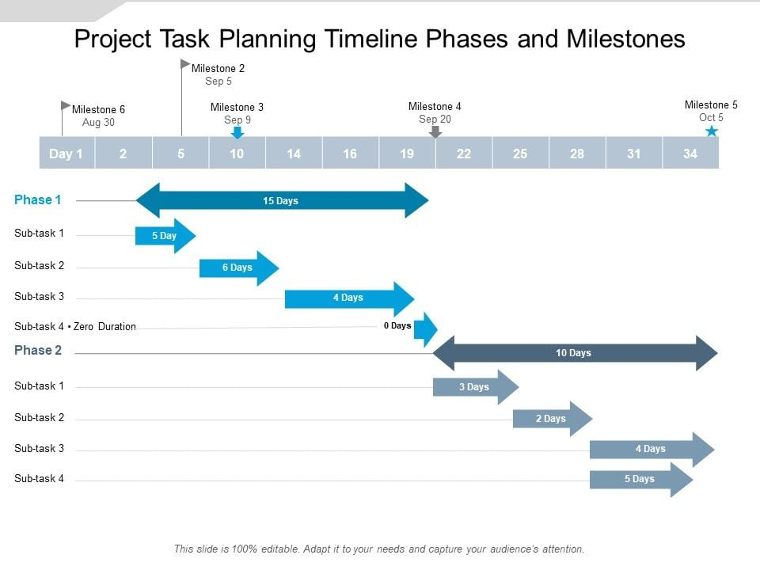
Timeline
Consider each of the major tasks in a logical order and determine how long it will take to achieve each task

Slide 23
Resources and Budget
What resources are needed for the research and how much will they cost.

Slide 24
Reference

